Slide 1
XGBoost algorithm
Understanding XGBoost Algorithm

Slide 2
What is XGBoost?
Definition: "XGBoost (Extreme Gradient Boosting) is a powerful machine learning algorithm used for regression and classification problems."
Highlight: "Known for its speed and performance."

Slide 3
Why Learn XGBoost?
Widely used in competitions (e.g., Kaggle)
Excellent performance in real-world applications
Versatile and can be used for various types of data

Slide 4
Basic Concepts of XGBoost
Boosting
Gradient Boosting: "A technique where new models correct the errors of existing models."
Learning
Ensemble Learning: "Combines predictions from multiple models to improve accuracy."

Slide 5
Features of XGBoost
Regularization: "Helps prevent overfitting."
Parallel Processing: "Speeds up training."
Tree Pruning: "Reduces complexity by removing unnecessary branches."

Slide 6
How XGBoost Works
Start with an initial prediction
Calculate residuals (errors)
Fit a new model to the residuals
Update the predictions
Repeat the process

Slide 7
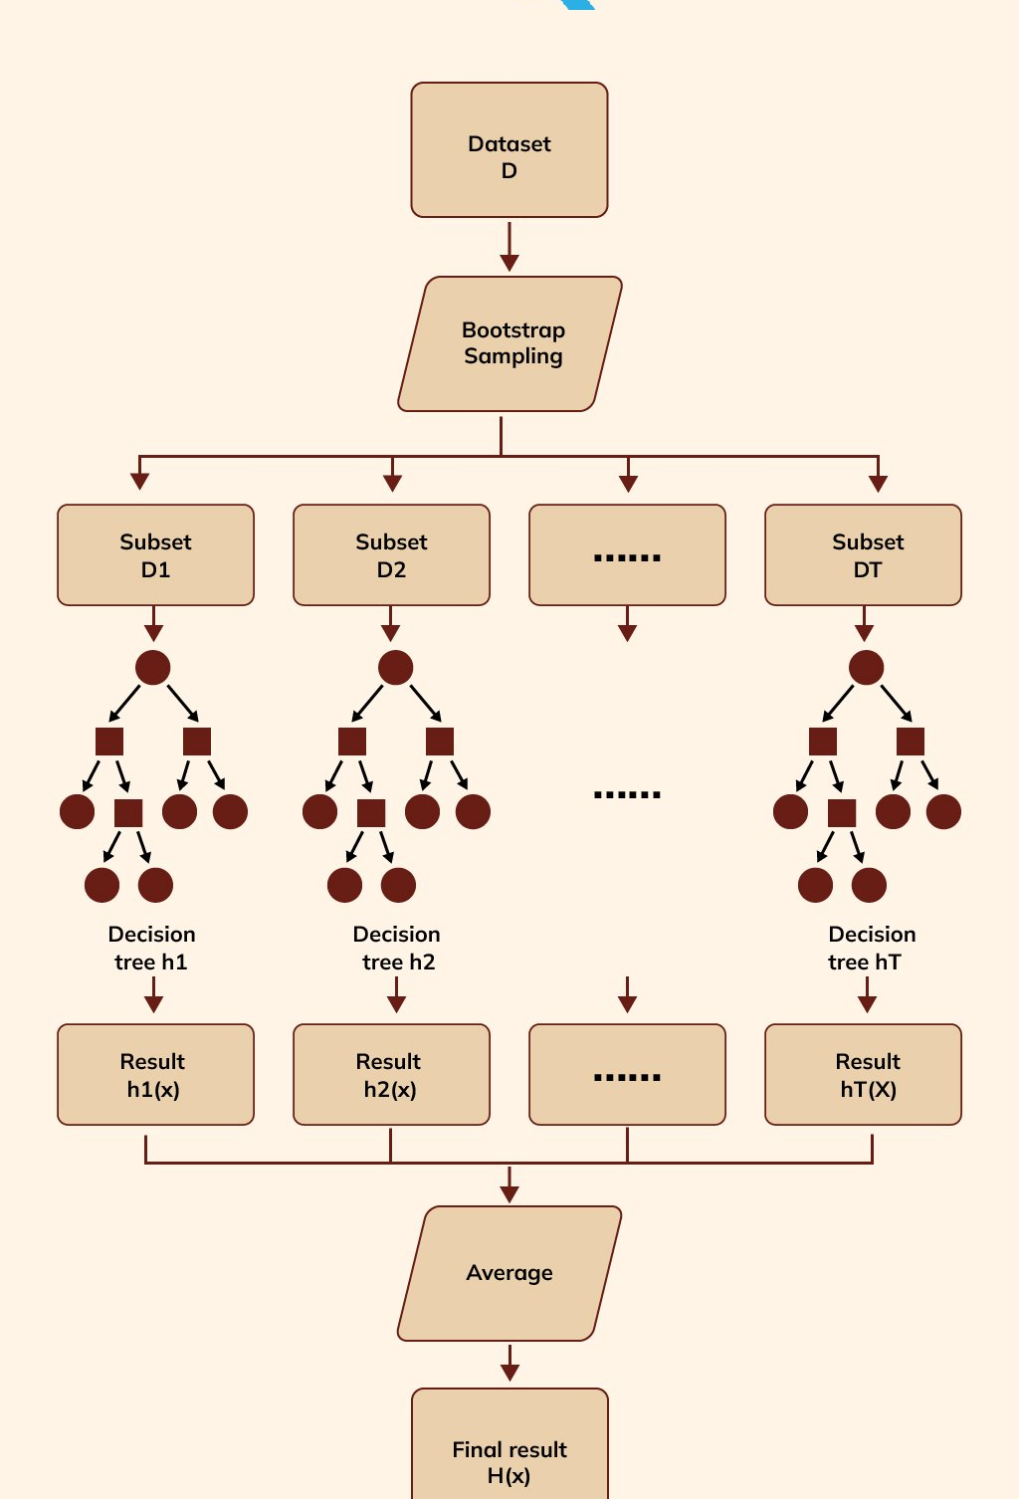
Visualization

Slide 8
Advantages of XGBoost
High Performance: "Faster and more accurate."
Flexibility: "Can handle missing values, categorical features, etc."
Robustness: "Less prone to overfitting due to regularization."

